Slide 1

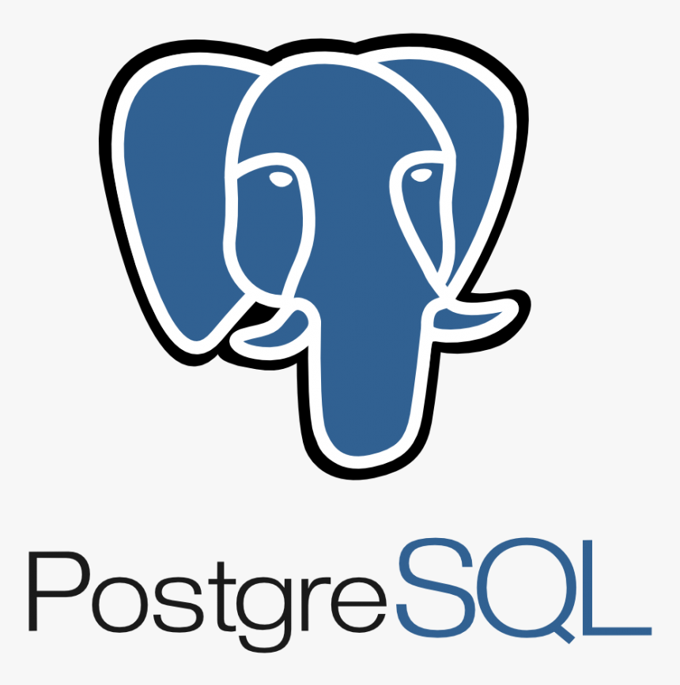
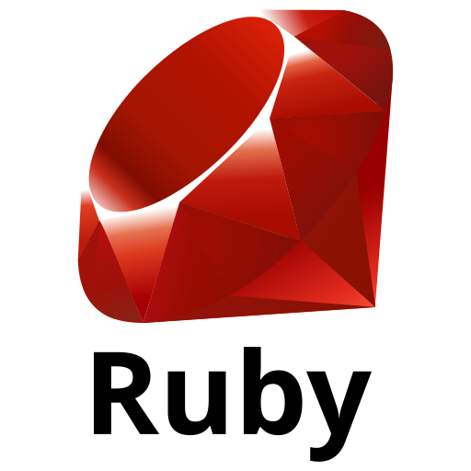
High-level logical Architecture
Web App
REST API
Database
HTTP
TCP

Slide 2
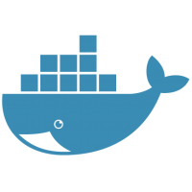
Deployment to Docker host
Docker host
Web App
REST API
Database
HTTP
TCP

Slide 3
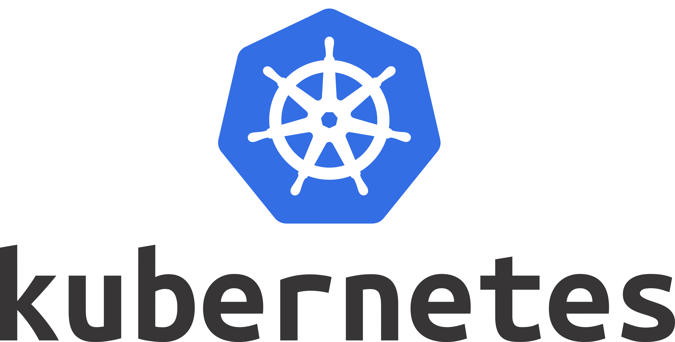
Deployment to Kubernetes cluster
K8s cluster
Pod instance ‘n’
Pod instance ‘n’
Pod instance 2
Pod instance 2
Cluster
Pod instance 1
Pod instance 1
Pod instance
Web App
REST API
Database
HTTP
TCP

Slide 4
Pod instance ‘n’
Pod instance 2
Pod instance 1

